Slide 1
HTML
(also CSS)

Slide 2

Hypertext Markup Language (HTML)
Not a programing language (sorry)
Denotes the structure or skeleton of a webpage
Is made up of “tags”
Is one of three “cornerstone technologies” for the web
Current version is HTML5, has been the standard since 2014

Slide 3

Cascading Style Sheets (CSS)
Also not a programing language
Used to style HTML documents (change colours, fonts, margins, etc)
As of 1997 is the standard for styling web pages (and other things)
Current version is CSS 3*
*Versioning in CSS is overly complicated, I only learned about it while making this presentation, everyone will get what you mean if you say CSS 3. Also older versions of CSS are written almost the same way. At least CSS 2 is.

Slide 4


Slide 5
To get started?
A text editor (Sublime Text, Notepad++)
A browser (Google Chrome)
A vast wealth of online resources (www.google.com)

Slide 6
HTML
Is built of “tags”
Regular tag: <body> … </body>
Self closing tag: <img … />
Sets the outline of the document (similar to the supports in a building)
All files follow the same “Boilerplate”

Slide 7
HTML boilerplate
<!DOCTYPE html>
<html>
<head>
<title></title>
</head>
<body>
</body>
</html>

Slide 8
HTML boilerplate
<!DOCTYPE html>
<html>
<head>
<title></title>
</head>
<body>
</body>
</html>

Slide 9
HTML boilerplate
<!DOCTYPE html>
<html>
<head>
<title></title>
</head>
<body>
</body>
</html>

Slide 10
HTML boilerplate
<!DOCTYPE html>
<html>
<head>
<title></title>
</head>
<body>
</body>
</html>

Slide 11
Some tags
<h1> HEADER TEXT </h1> , <h2> Header </h2> …. <h6> header </h6>
<p> Paragraph of text </p>
<img src=“https://www.website.com/picture_url”>
<a href=“https://www.google.com”>This is a hyper link now</a>

Slide 12
Lists
<ul>
<li>Thing 1</li>
<li>Thing 2</li>
</ul>
Or use <ol> for an ordered list
This these points
Vs. these points (this would be the ordered list element)

Slide 13
Tables
<table> <tr> <th>These are some text, some numbers and an image</th> </tr> <tr> <td>One</td> <td>12</td> <td><img src=http://www.image.com></td> </tr>
</table>
<tr> = “table row” <th> = “table header” <td> = “table data”

Slide 14
Tables (Not all on one line)
<table> <tr> <th>These are some text, some numbers and an image</th> </tr> <tr> <td>One</td> </tr> <tr> <td>12</td> </tr> <td><img src=http://www.image.com></td> </tr>
</table>
<tr> = “table row” <th> = “table header” <td> = “table data”

Slide 15
Lots of tags
https://www.w3schools.com/tags/default.asp

Slide 16
Lets try some!
Make a document with an h1, two h2s and two p tags (Put some text in them!)
Add an img tag and an “a” tag
Add a list with three elements (ul or ol tag and then li tags)

Slide 17
What to remember about HTML
It is made of up tags (either self closing or not)
It outlines the structure of the document and contains any text to be read by the user

Slide 18
What haven’t I told you about
<div> tag
Designed to format the document into the shape you want it (text box here, etc)
<input> and <form> tags
Used to take some form on input from the user (anything from passwords to color pickers)

Slide 19
CSS
Selector {
Property_1: Value;
Property_2: Value;
}
Either goes inside a <style> … </style> tag (like in the email)
Or in it’s own document with the <link> tag

Slide 20
Selectors
From least specific to most:
Elements (Think like “all p tags”)
Classes (“Families” of HTML objects)
IDs (A single or a few specific HTML objects)
Style attribute (Writing your style inside the HTML tag, don’t do this)
An ID will never be overwritten by a class, a class never by an element

Slide 21
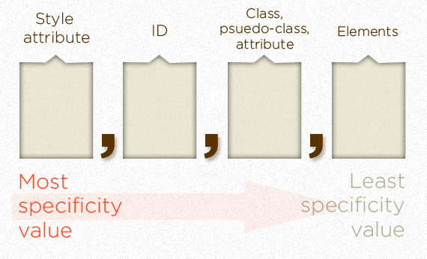

Slide 22
Specificity
https://specificity.keegan.st/

Slide 23
Element Selector
p {
font-family: times new roman;
}
What would this select?

Slide 24
Classes
Assigned to html elements as:
<table class=“name_of_class”> … </table>
Selected with CSS as:
.name_of_class {
font-weight: bold;
}
Should be used on groups of similar elements

Slide 25
Example class
.red_bold_text {
color: red; font-weight: bold; font-size: 18px;
}
<p class=“red_bold_text”> This text is important </p>

Slide 26
Ids
Assigned to html elements as:
<h1 id=“name_of_id”> … </h1>
Selected with CSS as:
#name_of_id {
color: grey;
}
Should be used to refer to a single or very few specific elements

Slide 27
Id example
<style> #myHeader { background-color: lightblue; color: black; padding: 40px; text-align: center; } </style> <h1 id="myHeader">My Header</h1>

Slide 28
Changing the monthly email

Slide 29
What didn’t I tell you about CSS
The box model
A model of how white space/element spacing work in webpages
Lots of advanced functionality that I don’t know
http://www.csszengarden.com/

Slide 30
Resources
https://www.w3schools.com/
Tutorials, extensive references (documentation)
If you learned a tenth of what’s here you’re hireable at Google
https://stackoverflow.com
The #1 programing questions and answers website
Be careful about asking questions, it’s more useful to see previously answered questions (Yours probably isn’t new)
https://developer.mozilla.org/en-US/
More tutorials, more references

